Slide 1

Maharashtra In-service Teacher Resource App
Maharashtra’s Contribution & Vision For National Teacher Platform

Slide 2
Maharashtra’s Vision
Based on Pragat Shaikshanik Maharashtra Objectives
100% children in classrooms and learning.
Assessing professional development needs of 100% teachers and providing training on demand.
Support and mentoring for 100% teachers.
100% teachers to have access to high quality resources at their fingertips.
100% teacher voice to reach the M.A.A. and strengthen policy.

Slide 3
Background to MITRA
Tech-Savvy Teachers Movement
1,50,000
Tech-Savvy Teachers
80,000
Tech-Savvy Teachers
8,000
Tech-Savvy Teachers
6,756
Websites/Blogs
September 2015
September 2016
March 2017
98,987
Videos
2,783
Apps

Slide 4
Background to MITRA
Why MITRA
FOR TEACHERS
Get news and updates from the Government
Access state / district level training schedules and content
Find curriculum aligned, teacher created resources to use in their classroom
Create and share their own resources with the state teacher community
FOR ADMINISTRATORS
Direct channel of communication with teachers to send important announcements & updates.
Take surveys, polls, broadcast notifications and capture responses
View interactive dashboard and reports with statistics on usage, need analysis based on surveys
Information on training preferences of teachers, demand for particular trainings and attendee lists

Slide 5


Slide 6
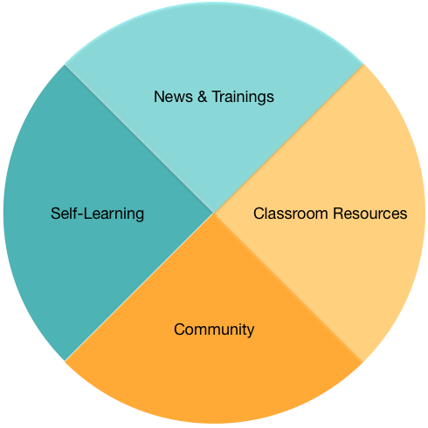
MITRA - Product
Product Components + Current Usage
83,000 downloads
41,000 teachers use MITRA at least once a month
21,000 teachers use MITRA weekly
Average engagement per user : 4 minutes 15 seconds

Slide 7
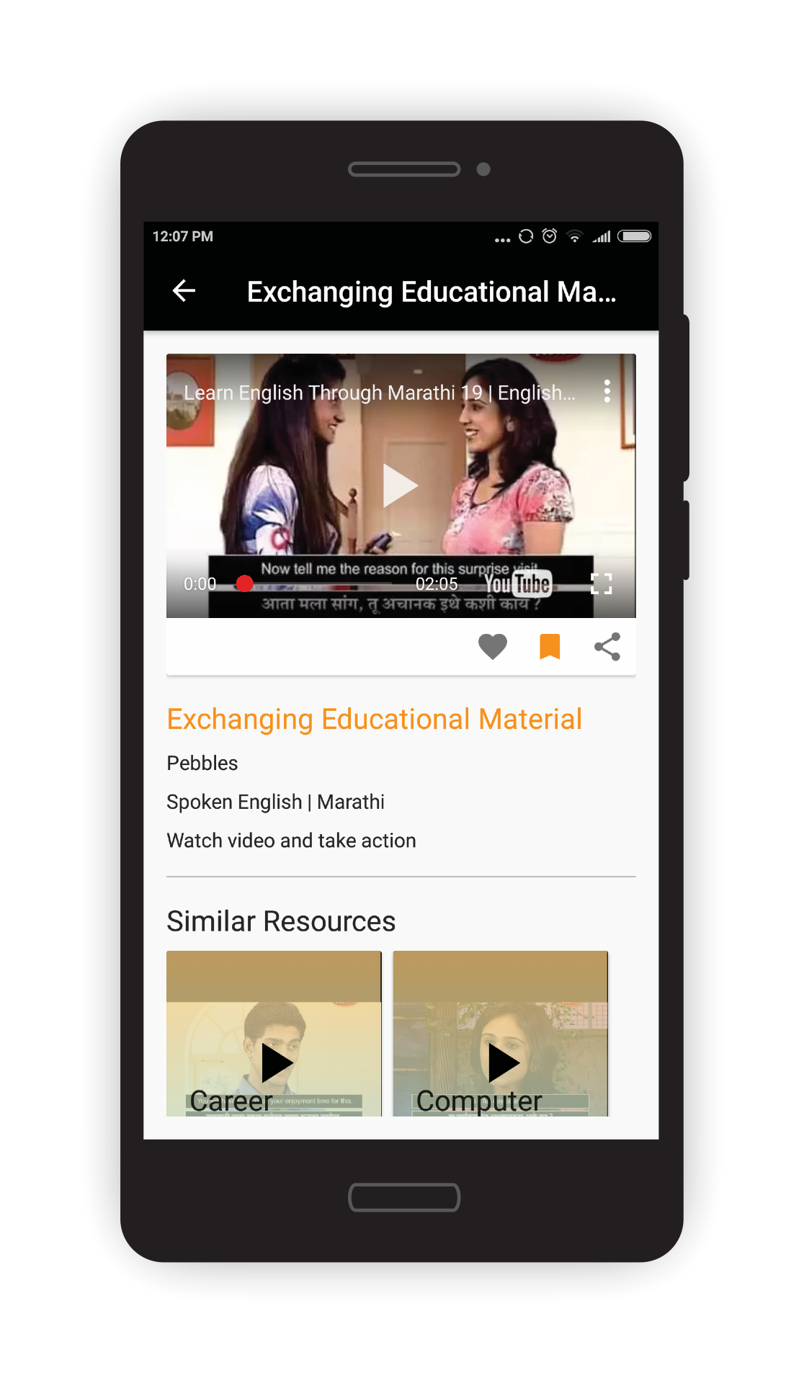
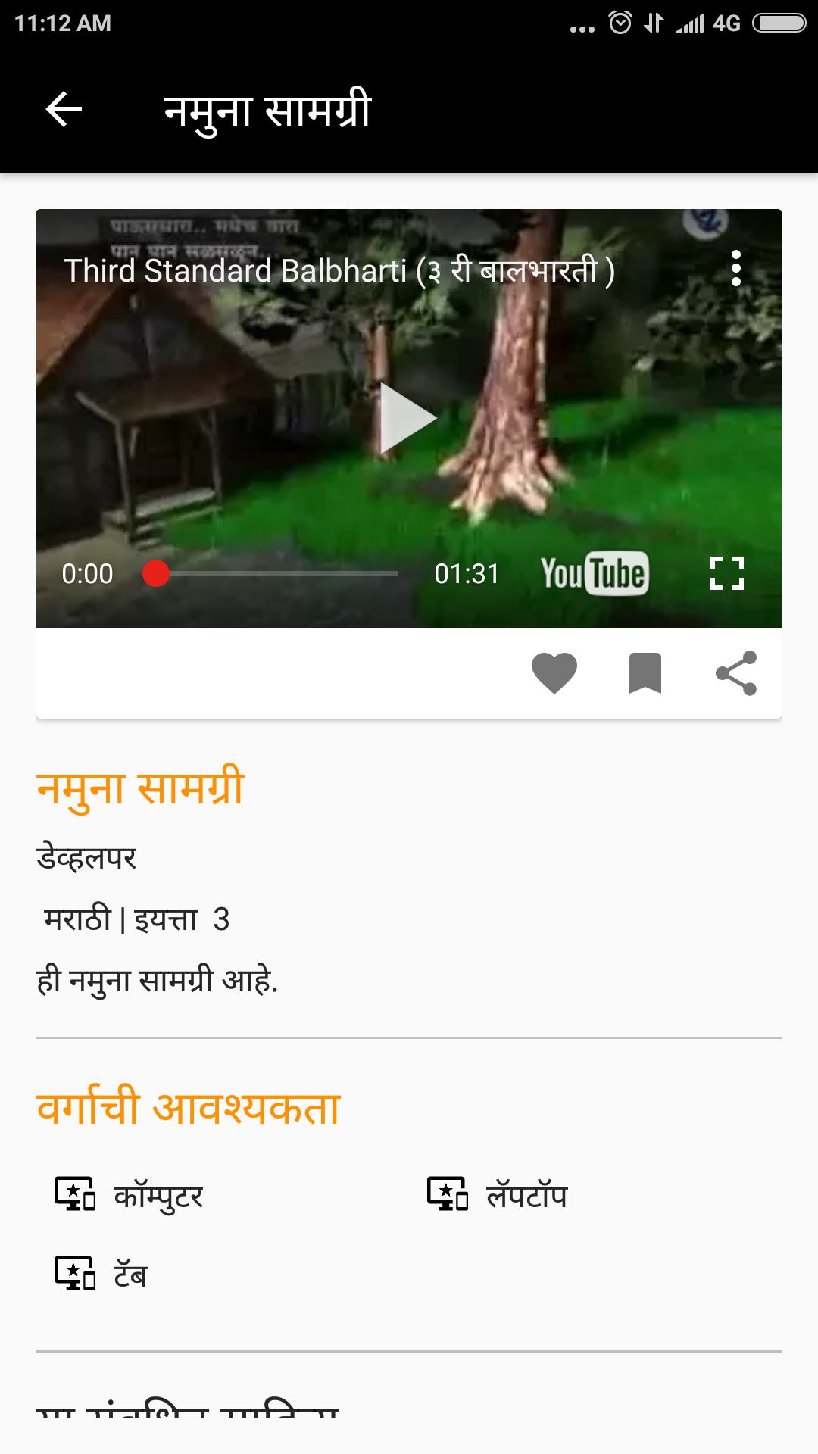
MITRA - Content
2000 videos
for teachers’ self learning
500 teaching resources created by teachers using EkStep
200 teachers trained in EkStep content creation
Over 10,000 content pieces curated by the MAA IT cell
5000 teaching resources
for grades 1-4, English, Marathi, Maths

Slide 8
MITRA - Outreach
MITRA Yatra
Lead by : MAA IT cell + DIECPD IT cell + State PMU
Objectives :
Understanding ground realities in every district of the state for adoption of technology
Collecting first hand feedback from teachers, HMs, CRPs & students on various technology initiatives by the state
Sharing of best practices & initiatives of using technology across districts
Familiarizing teachers with the MITRA app and it’s use

Slide 9
MITRA Yatra
1st Yatra – Nandurbar District
3 days
20 schools across all blocks
1400 teachers trained

Slide 10
MITRA - NTP
Director, MAA
PMU (LFE)
English Dept, MAA
Marathi Dept, MAA
Maths Dept, MAA
...
2 member IT cell, DIECPD
Subject Expert, DIECPD
Expert Teachers
Subject Experts, DIECPD
Expert Teachers
Subject Experts, DIECPD
Expert Teachers
Tech Savvy Teacher Champions
IT Cell MAA
Project Lead
Content Manager
Outreach Manager
Product Manager
Support + Admin Structures
Headed by: Director, MAA
Lead by : MAA IT cell + DIECPD IT cell + MAA Subject Departments.
Supported by: DIECPD subject experts + Expert Teachers + Tech Savvy Champions, PMU under LFE

Slide 11
MITRA - NTP
Content Curation Roles + Workflow
Notification sent to Math Dept
Content created and sent for review
Teachers in District A
Content is reviewed for appropriateness & hygiene
District A DIECPD IT cell
Math content is published
Notification sent to English Dept
Published Content is expert curated
English content is published
Notification sent to Marathi Dept
Marathi content is published
MAA Subject Deprtments

Slide 12
MITRA - NTP
Intent + Leadership Area
Pre-service to Pension Teacher Registry
Use SARAL+ Shalarth teacher database to create Teacher Registry
Award credits to teachers for trainings taken which reflect in teachers CR
Strong Online + Offline Teacher Communities
Study existing teacher communities through field research and replicate similar structures online.
Contribute to Teacher Stories and other incentivization features on NTP
Content Creation By Teachers For Teachers
Conduct workshops on content authoring for teachers
All content aligned to subject, grade and chapters
Allow users to define and raise quality standards through consumption data

